Slide 1

VISVESVARAYA TECHNOLOGY UNIVERSITY, BELAGAVI
BALLARI INSTITUTE OF TECHNOLOGY AND MANAGEMENT
DEPARTMENT OF COMPUTER SCIENCE AND ENGINEERING
BREAST CANCER CLASSIFICATION AND IDENTIFICATION
USING MACHINE LEARNING TECHNIQUES
AKASH S TELKAR 3BR17CS004
JYOTHI LAXMI 3BR17CS058
KR VIJAY KUMAR 3BR17CS063
K JYOYTHI 3BR17CS067
UNDER THE GUIDENCE OF:
DR. JAGADEESH R M
ASSISTANT PROFESSOR, CSE

Slide 2
ABSTRACT
1
Breast cancer is the most common cancer amongst women in the world. It accounts for 13% of all cancer cases and affected over 2.7 Million people in 2019 alone. The key challenges against its detection is how to classify tumors into malignant (cancerous) or benign (non-cancerous) using features obtained from several cell images and we make use of machine learning techniques to carry out the above task with best possible accuracy. We make use of Wisconsin Breast cancer dataset which consists of the features computed from digitized images of FNA (fine needle aspirate) tests on a breast mass.
Early detection of breast cancer aids for early diagnosis and treatment, because the prognosis is very important for long-term survival. Machine Learning based models predict the cancer disease very fast and accurate thus play significant role in saving life of patient.

Slide 3
OBJECTIVES
2
To come up with detailed and proper literature review of the previously done research works or existing systems.
To identify the limitations and research challenges of existing system.
To choose the appropriate data set for our project.
To propose a model which can efficiently predict and classify the type of cancer in very early stages of diagnosis.
To create a model that takes the data regarding the cell nucleus from the breast cell mass and predicts the type of cancer with reasonably high accuracy.
To broader view, the project aims at reducing the mortality rate in women that is caused by the breast cancer.

Slide 4
PROBLEM STATEMENT
3
The main task of the project to classify the tumors as Malignant(cancerous) or Benign(non cancerous).

Slide 5
LITERATURE SURVEY
5
Author | Title | Algorithm | Data-set | Advantages | Limitations
Ashraf O. I. and Siti M. S [1] | Intelligent breast cancer diagnosis based on enhanced Pareto optimal and multilayer perceptron neural network | MLP + NSGA II | Wisconsin Breast Cancer Database | Good accuracy and Optimized network structure | MLP can get stuck in local minima
Na, L., Qi, E., Xu, M., Bo, G., Gui-Qiu, L [2] | A novel intelligent classification model for breast cancer diagnosis | IGSAGAW + CSSVM | Wisconsin Breast Cancer Database | Good performance | Computationally expensive

Slide 6
6
Author | Title | Algorithm | Data-set | Advantages | Limitations
Abdulkader, H., John, B. I., Rahib, H.A [3] | Machine learning techniques for classification of breast tissue | BPNN + RBFN | From UCI repository using EIS(Electrical impedance spectroscopy) method | Good accuracy and training time | stuck in a local minima
Kemal, P., and mit [4] | A Novel ML Approach to Prediction of Breast Cancer | MAD normalization method+ KMC+ AdaBoostM1 classifier | BCC(Breast Cancer Coimbra) data set | Good performance | Computationally expensive
Teresa, A., Guilherme, A., Eduardo, C., Jos, R., Paulo, A., Catarina, E., Antnio, P., and Aurlio, C [5] | Classification of breast cancer histology images using Convolutional Neural Networks | CNN (Convolution Neural Networks) | Image dataset | Good accuracy | Data-efficient learning - Uncertain model

Slide 7
7
Author | Title | Algorithm | Data-set | Advantages | Limitations
Hiba, A., Hajar, M., Hassan, A. M., and Thomas, N [6] | Using Machine Learning Algorithms for Breast Cancer Risk Prediction and Diagnosis | C 4.5 | Wisconsin Breast Cancer Database | Fast prediction | may generate combinatorial explosion
MLP: Multi Layer Perceptron
NSGA II: Non-dominated Sorting Genetic Algorithm
IGSAGAW: Information Gain Directed Simulated Annealing Genetic Algorithm Wrapper
CSSVM: Cost Sensitive Support Vector Machine
BPNN: Back Propagation Neural Network
RBFN: Radial Basis Function Network
KMC: K-Means Cluster
MAD: Median Absolute Deviation

Slide 8
REQUIREMENT ANALYSIS
8
Hardware Requirements
Processor: Intel Core Duo 2.0 GHz or more
RAM: 1GB or more
Hard disk: 80GB or more
Software Requirements
Python 3.7
Anaconda
SciKit-learn
MatPlotLib
SeaBorne

Slide 9
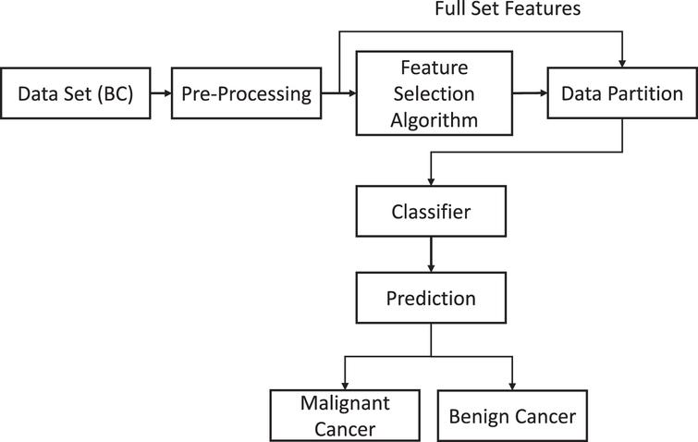
DATAFLOW DIAGRAM
9

Slide 10
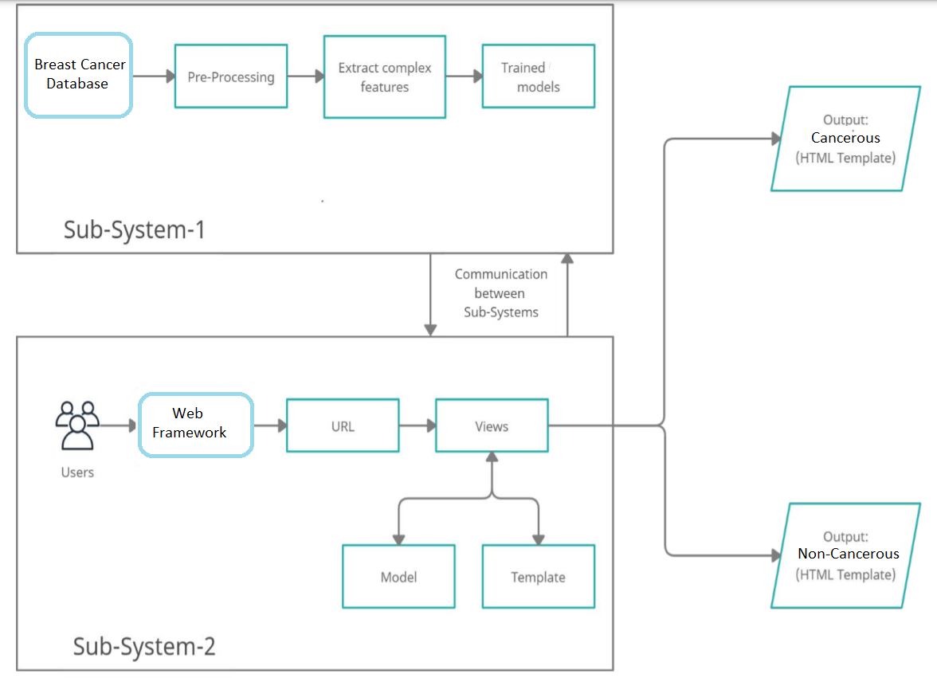
SYSTEM DESIGN
10

Slide 11
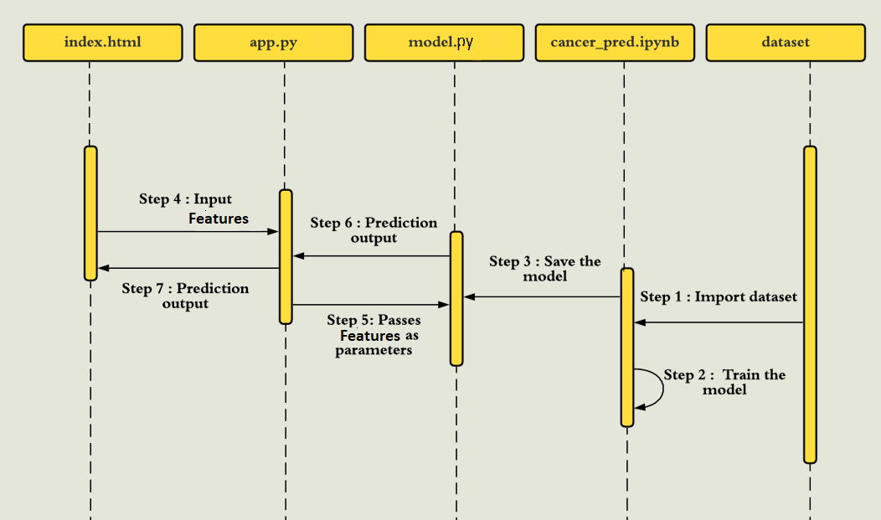
BEHAVIOURAL DESIGN
11
Sequence diagram

Slide 12
DATA EXPLORATION
12
The above mentioned data set has a number of diagnosis of lumps and masses that were found in the patients. Based on the diagnosis the tumor or lump is either classified as malignant (denoted by letter 'M') or benign (denoted by letter 'B’).
Ten real-valued features are computed for each cell nucleus:
  Radius
  Texture
  Perimeter
  Area
  Smoothness
6. Compactness
7. Concavity
Concave points
Symmetry
Fractal dimension

Slide 13
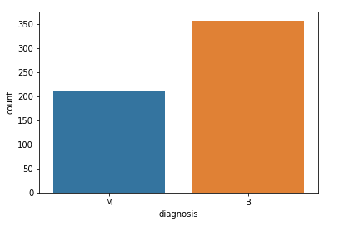
13
The mean, standard error and “worst” or largest (mean of the three largest values) of these features were computed for each image, resulting in 30 features. For instance, field 3 is Mean Radius, field 13 is Radius SE, field 23 is Worst Radius.
The dataset contains 569 entries (rows) and 32 columns
It can be observed from the above plot that there were 357 cases in which the diagnosis of the lump/tumor was benign, and there were about 212 cases in which the prognosis was malignant

Slide 14
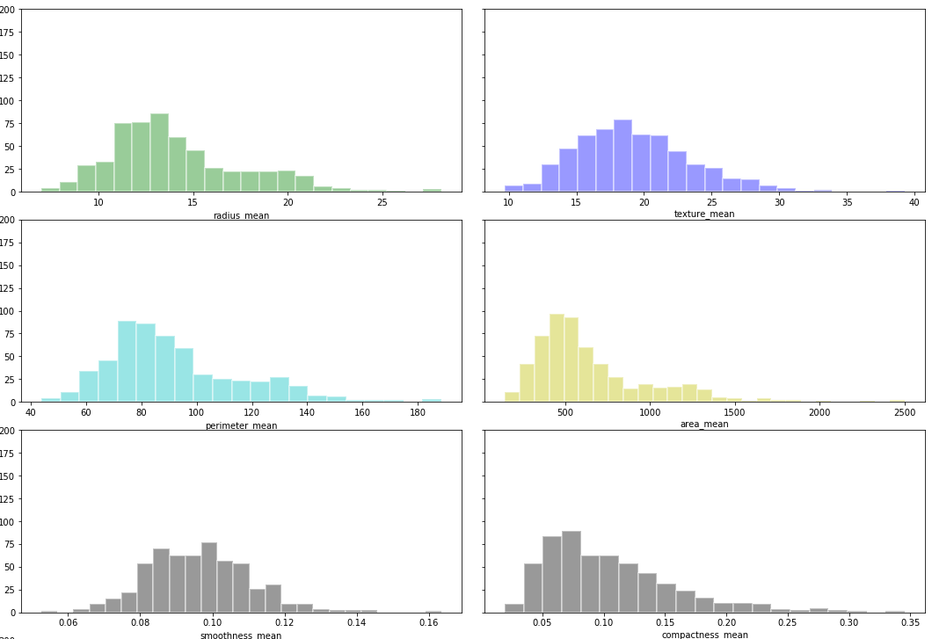
14
DATA VISUALISATION

Slide 15
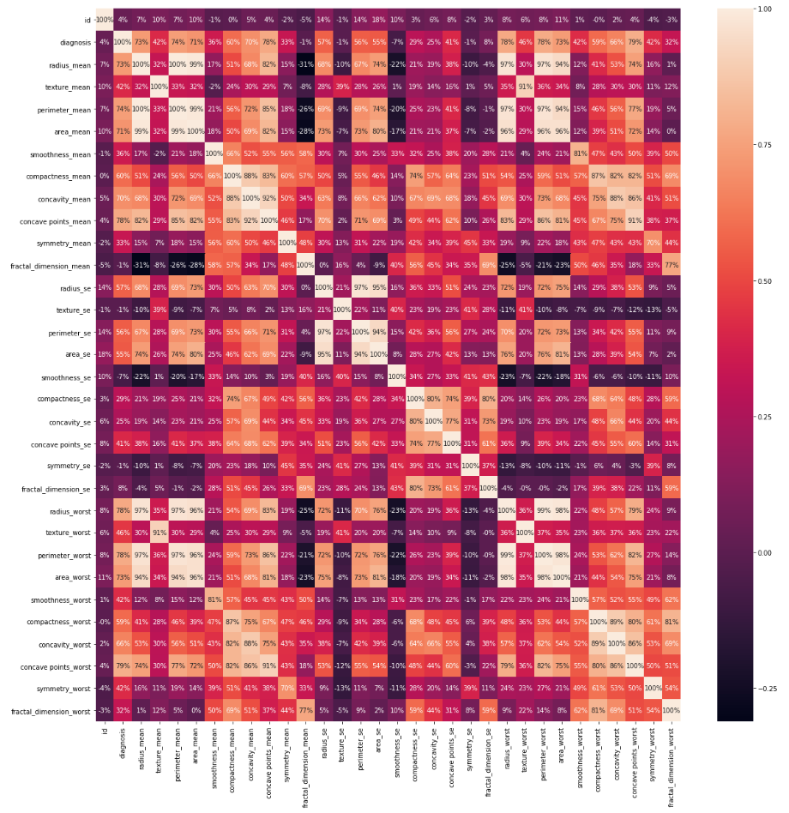
15
It can be observed that all the attributes of this data set follows more or less a normalized distribution.
It can be observed from the relationship plot that the lump/node attribute have a linear relationship with one another. As seen from the correlation matrix map and the mean radius of the lump varies linearly/proportionally with the mean texture. The same is the case with almost all the parameters involved in the diagnosis

Slide 16
CATEGORICAL DATA AND FEATURE SCALING
16
There are no missing values in the dataset
Categorical data are variables that contain label values rather than numeric values. The number of possible values is often limited to a fixed set.
We will use Label Encoder to label the categorical data. Label Encoder is the part of SciKit Learn library in Python and used to convert categorical data, or text data, into numbers, which our predictive models can better understand.(0-B,1-M)
Most of the times, your dataset will contain features highly varying in magnitudes, units and range. But since, most of the machine learning algorithms use Euclidian distance between two data points in their computations
We need to bring all features to the same level of magnitudes. This can be achieved by scaling. This means that you’re transforming your data so that it fits within a specific scale, like 0–100 or 0–1

Slide 17
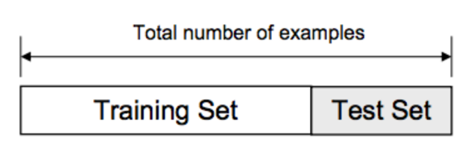
DATA SPLITTING
17
The data we use is usually split into training data and test data.
The training set contains a known output and the model learns on this data in order to be generalized to other data later on. We have the test dataset (or subset) in order to test our model’s prediction on this subset.
We will do this using SciKit-Learn library in Python using the train_test_split method.

Slide 18
MODEL SELECTION
LOGISTIC REGRESSION
18
Logistical regression method of classification is a quite famous algorithm that being used to solve a variety of problems involving "Binary Classification" of the data.
Some of the example of the Logistical Regression problems are:
1) Spam vs Ham email deduction.
2) Loan Default chances (yes/no) based on customer transaction data.
3) Disease diagnosis.
The convention for binary classification is to have two classes 0 and 1. We can't use linear regression on these binary groups as they won't lead a good fit. Instead we use a sigmoid function to classify the data. The sigmoid function takes in any values and gives an output between 0 & 1

Slide 19
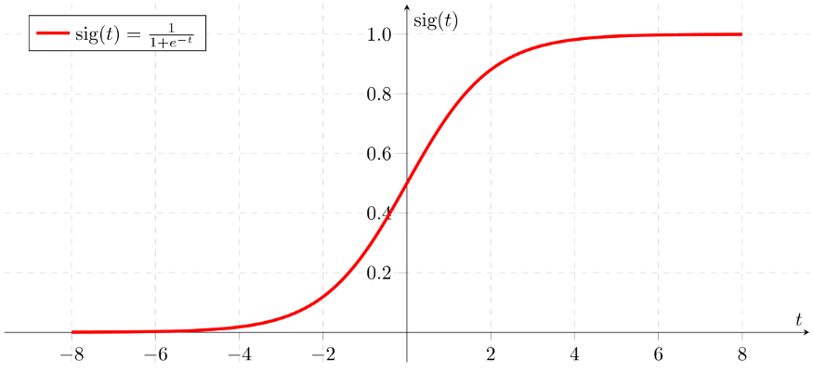
SIGMOID FUNCTION
19

Slide 20
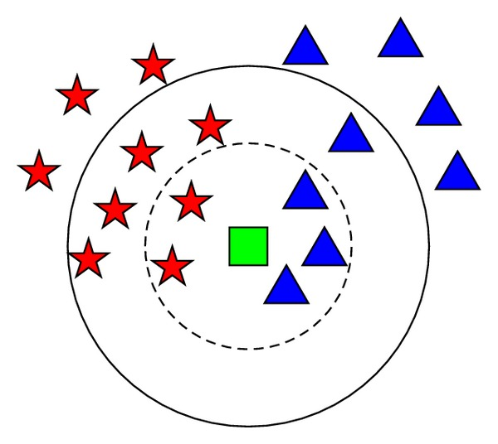
K-NEAREST NEIGHBOR
20
K Nearest Neighbors is a classification algorithm that operates on a very simple principle. It's a non-parametric method of classification.
Majority voting among the data records in the neighborhood is usually used to decide the classification of the dataset with or without consideration of distance-based weighting. However, to apply KNN we need to choose an appropriate value for "k", and the success of classification is very much dependent on this value.

Slide 21
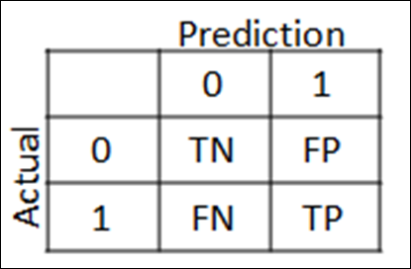
CLASSIFICATION REPORT
21
The confusion matrix tells us how many patients each model misdiagnosed (number of patients with cancer that were misdiagnosed as not having cancer a.k.a false negative, and the number of patients who did not have cancer that were misdiagnosed with having cancer a.k.a false positive) and the number of correct diagnosis, the true positives and true negatives.

Slide 22
22
Classification report for logistic regression:
Confusion Matrix [[108 3]
    [ 3 57]]
    Accuracy of the model: 96.49%
    Error/ Misclassification rate: 3.51%
    Classification report for KNN:
    Confusion Matrix [[89 1]
      [ 5 48]]
      Accuracy of the model: 95.80%
      Error/Miscalculation rate: 4.20%

Slide 23
RESULTS AND DISCUSSION
23

Slide 24
SNAPSHOTS
24

Slide 25
TESTING
25

Slide 26
CONCLUSION
26

Slide 27
PAPER PUBLICATION
27

Slide 28
REFERENCES
28
[1] . Ashraf, O. I. and Siti, M. S.: Intelligent breast cancer diagnosis based on enhanced Pareto optimal and multilayer perceptron neural network. International Journal of Computer Aided Engineering and Technology, Inderscience, Vol. 10, No. 5, pp. 543-556(2018)
[2] Na, L., Qi, E., Xu, M., Bo, G., Gui-Qiu, L.: A novel intelligent classification model for breast cancer diagnosis. Information Processing and Management, Elsevier, pp. 609-623(2019)
[3] Abdulkader, H., John, B. I., Rahib, H.A.: Machine learning techniques for classification of breast tissue. In: 9th International Conference on Theory and Application of Soft Computing, Computing with Words and Perception, ICSCCW, pp. 402-410. Procedia Computer Science, Elsevier. Budapest, Hungary (2017)

Slide 29
29
[4] Kemal, P., and mit, .: A Novel ML Approach to Prediction of Breast Cancer: Combining of mad normalization, KMC based feature weighting and AdaBoostM1 classifier. In: 2nd International Symposium on Multidisciplinary Studies and Innovative Technologies (ISMSIT),IEEE, pp. 1-4 (2018)
[5] Teresa, A., Guilherme, A., Eduardo, C., Jos, R., Paulo, A., Catarina, E., Antnio, P., and Aurlio, C.: Classification of breast cancer histology images using Convolutional Neural Networks. PLOS ONE, pp. 1-14 (2017)
[6] Hiba, A., Hajar, M., Hassan, A. M., and Thomas, N.: Using Machine Learning Algorithms for Breast Cancer Risk Prediction and Diagnosis. In: The 6th International Symposium on Frontiers in Ambient and Mobile Systems (FAMS),Procedia Computer Science, Elsevier, pp. 1064-1069 (2016).
[7] Machine Learning: A Guide to Current Research - Tom Mitchell
[8] Mathematics for Machine Learning Textbook by A. Aldo Faisal, Cheng Soon Ong, and Marc Peter Deisenroth
[9] Hands-On Machine Learning with Scikit-Learn, Keras, and TensorFlow: Concepts, Tools, and Techniques to Build Intelligent Systems Book by Aurelien Geron

Slide 30
THANK YOU

